Slide 1

Facility Reservations
Click to Begin

Slide 2
Error!
Please follow the on-screen
instructions to continue.
Go Back

Slide 3
Complete
Please navigate to the next module
in the course to continue.
Restart Course

Slide 4
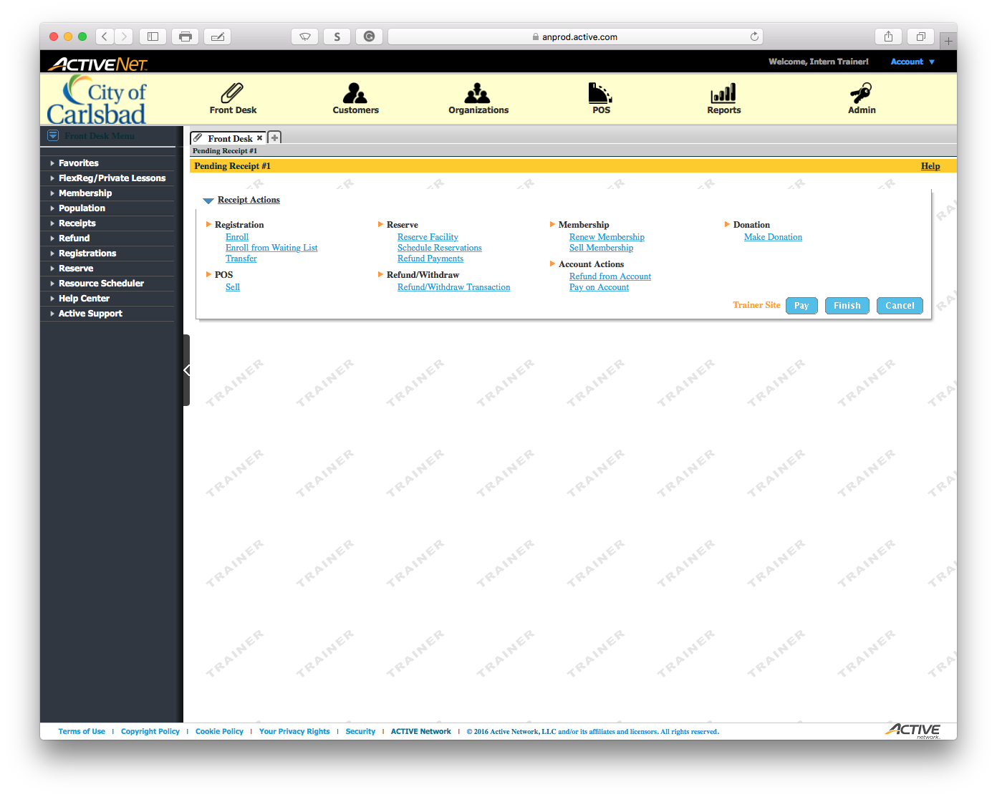
Tip:
Main Text Instruction Will Go Here
Select Resource Scheduler
Sub Instruction Here
This is the best way to visualize all availability.

Slide 5
Error!
Please follow the on-screen
instructions to continue.
Go Back

Slide 6
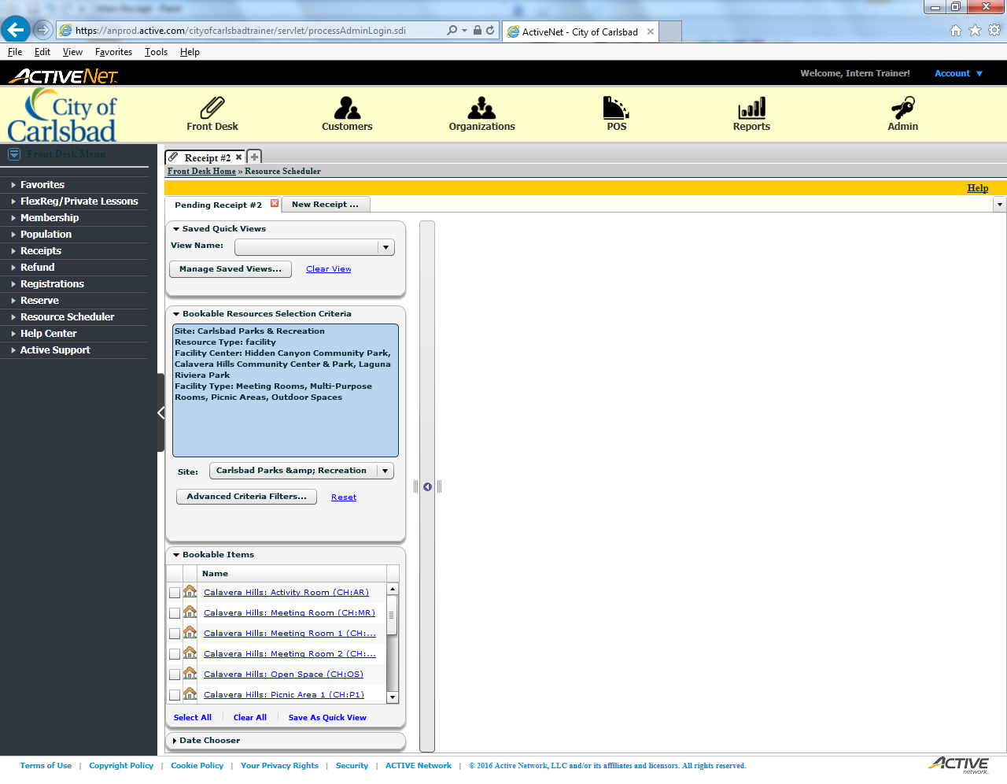
Tip:
Select Advanced Criteria Filters
Sub Instruction Here
Subtext here.
We need to select a facility for the reservation.

Slide 7
Error!
Please follow the on-screen
instructions to continue.
Go Back

Slide 8
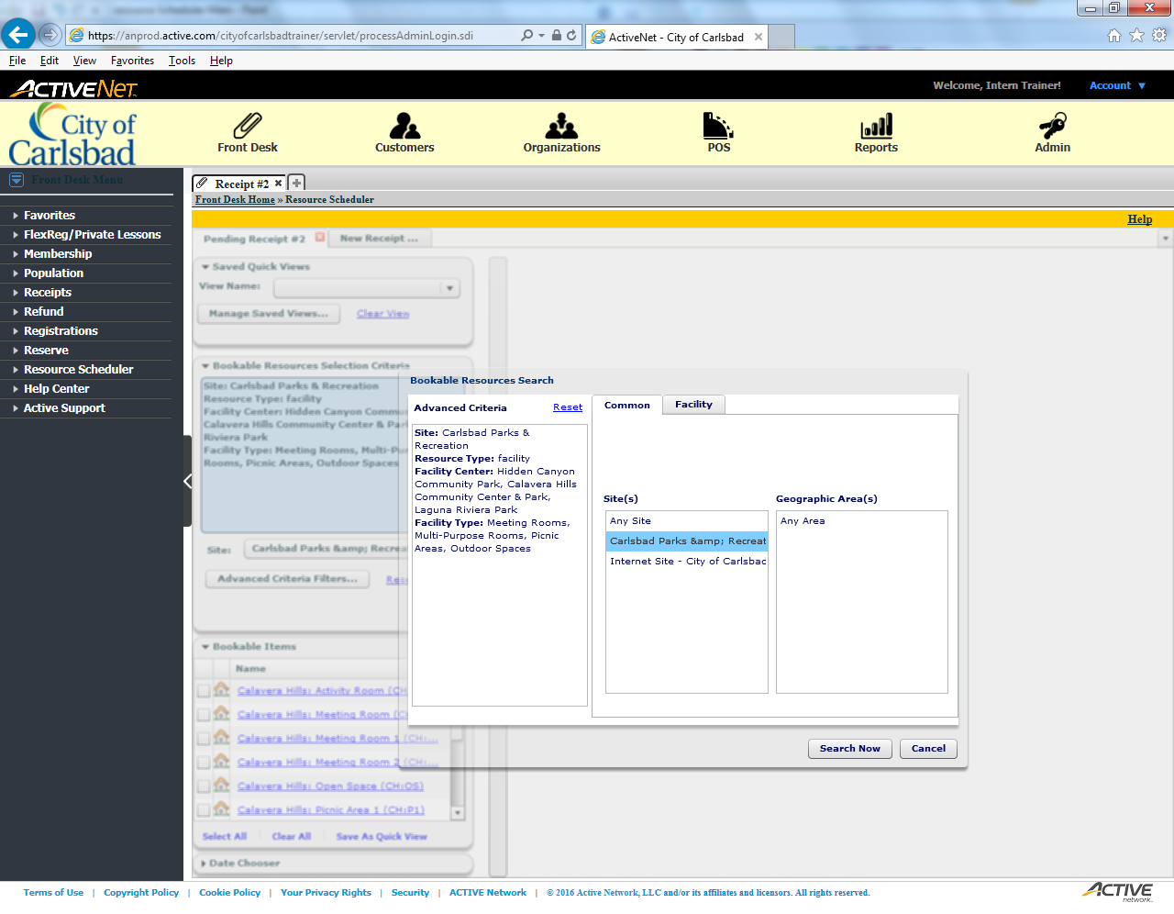
Tip:
Select Facility

Slide 9
Error!
Please follow the on-screen
instructions to continue.
Go Back

Slide 10
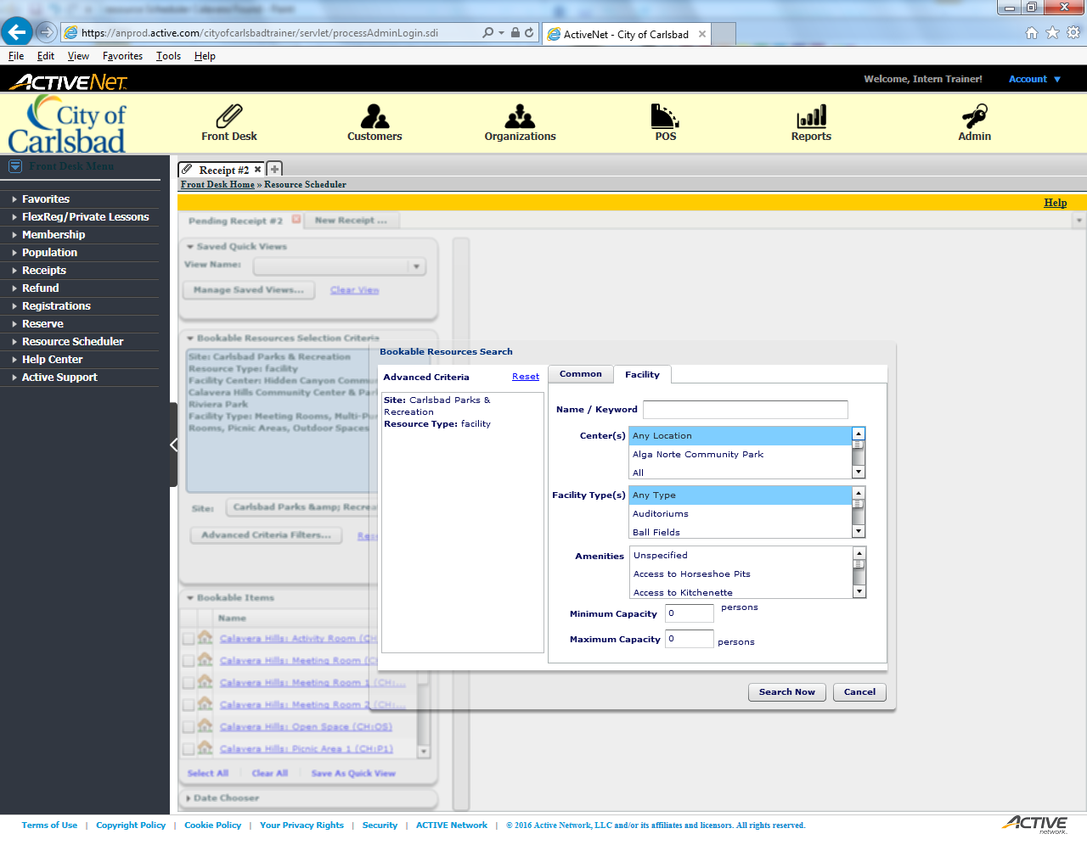
Tip:
Scroll to Find Calavera Hills

Slide 11
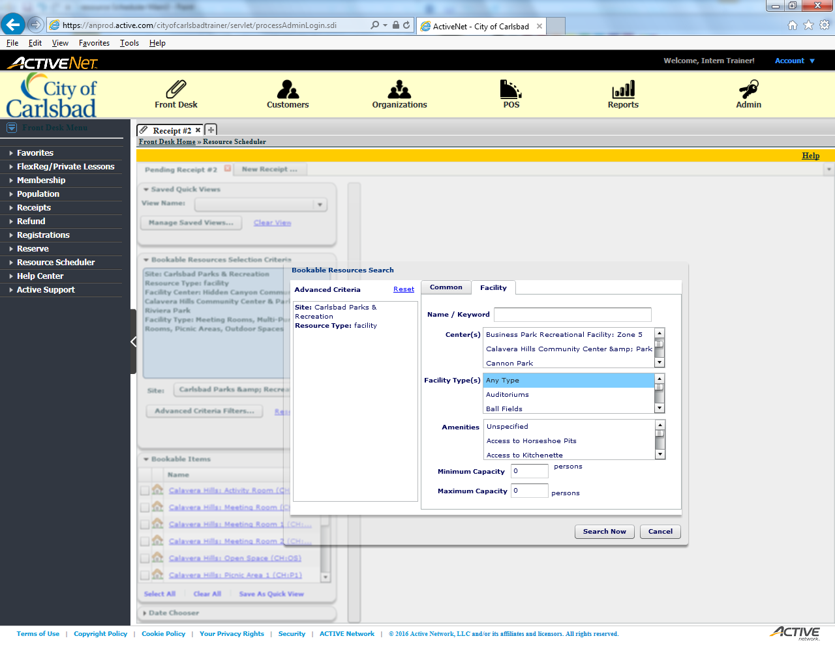
Tip:
Select Calavera Hills Community Center

Slide 12
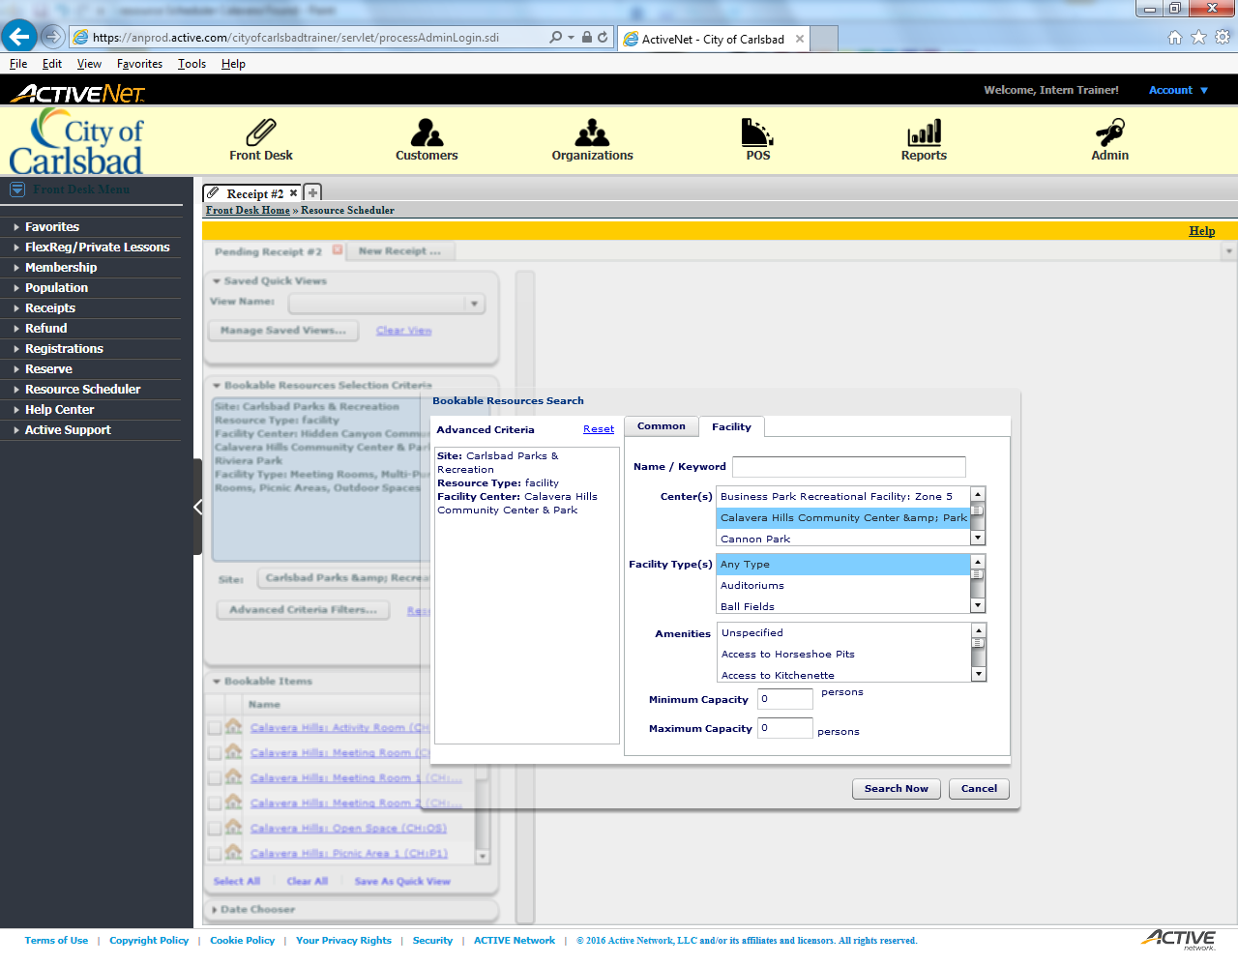
Tip:
Scroll to locate Picnic Areas

Slide 13
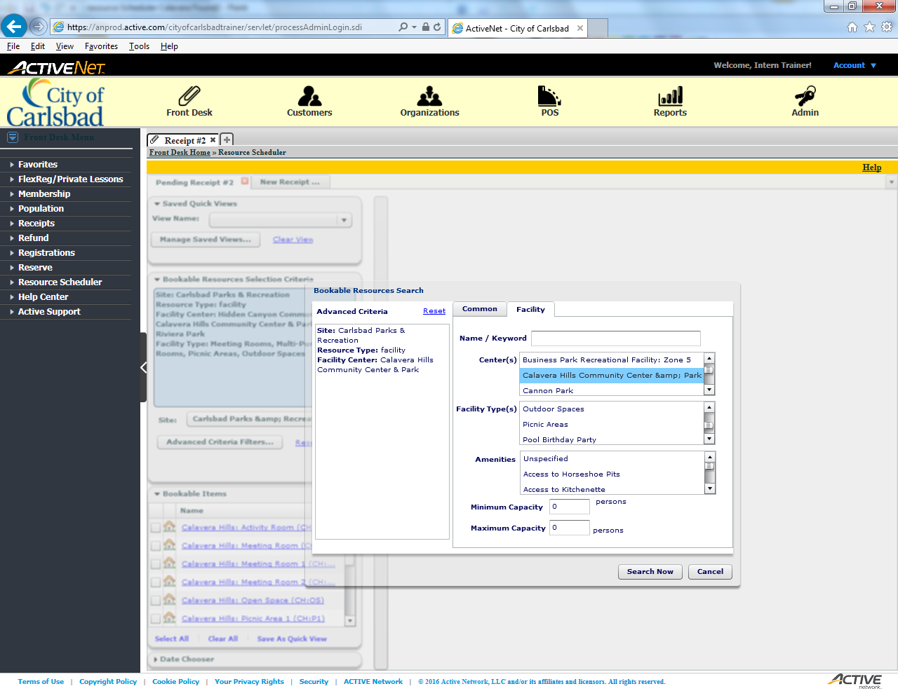
Tip:
Select Picnic Areas

Slide 14
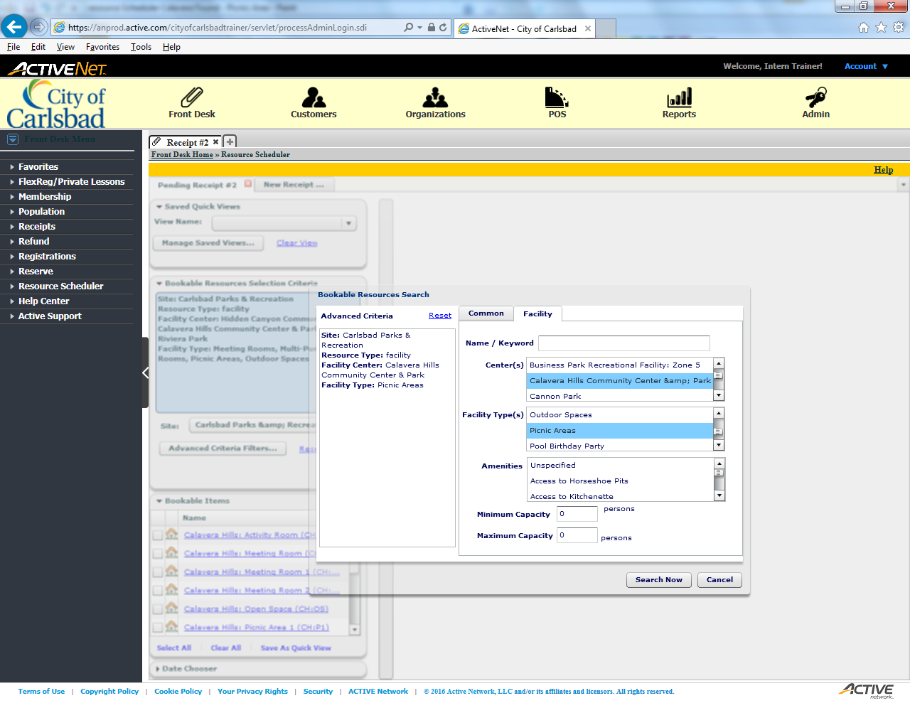
Tip:
Search for matching locations

Slide 15
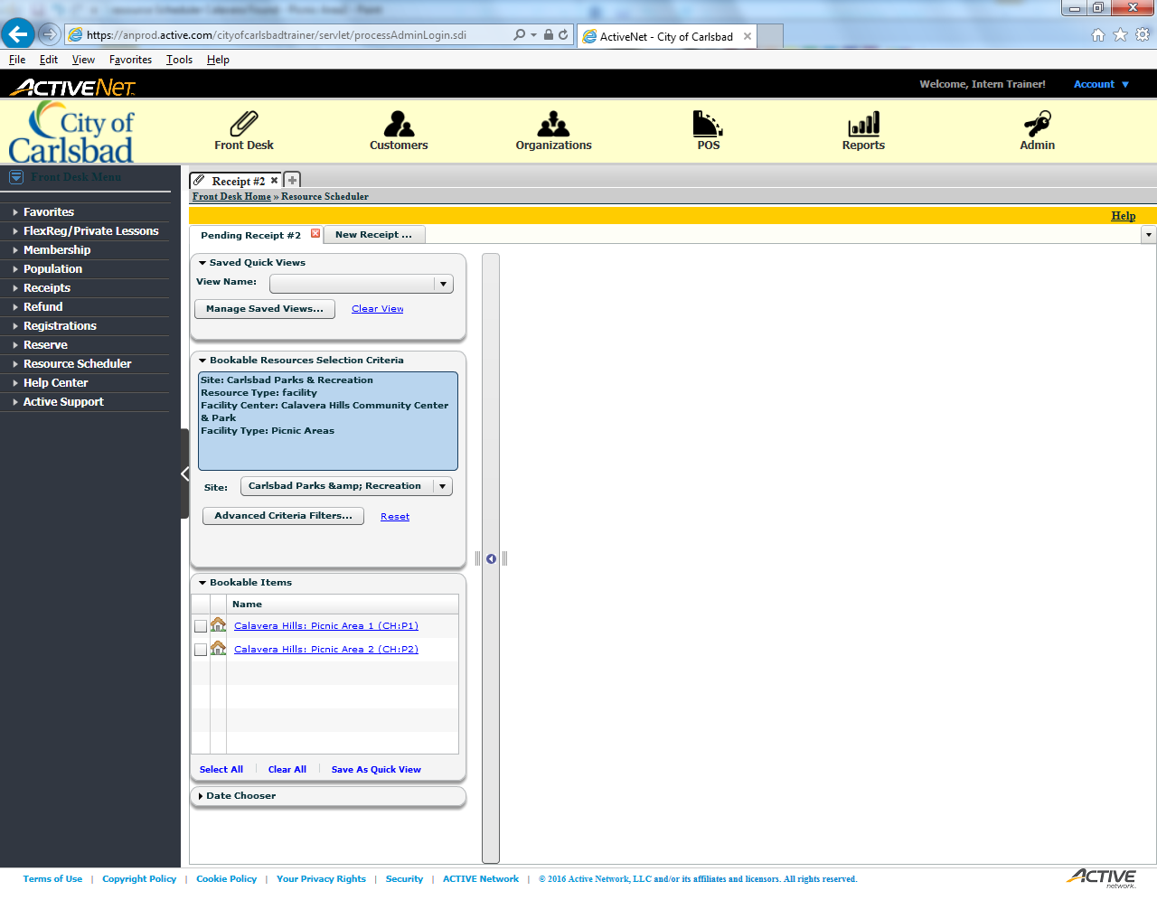
Tip:
Check Picnic Area #1

Slide 16
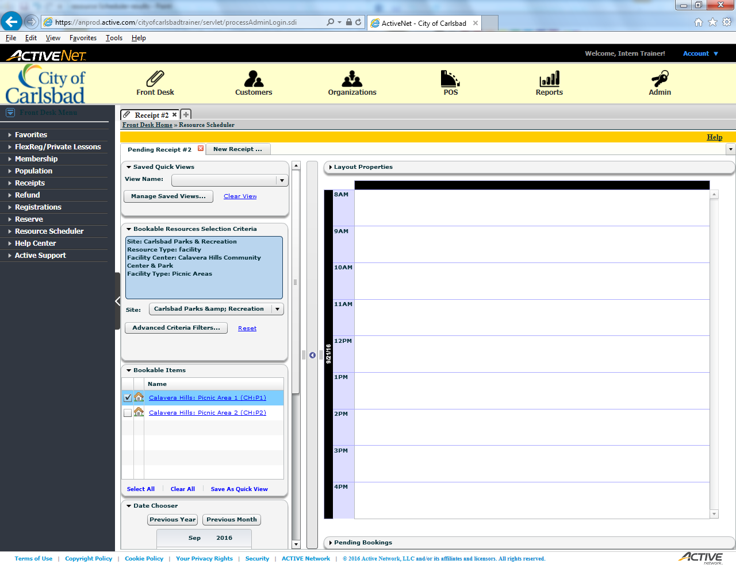
Tip:
Check Picnic Area #2

Slide 17
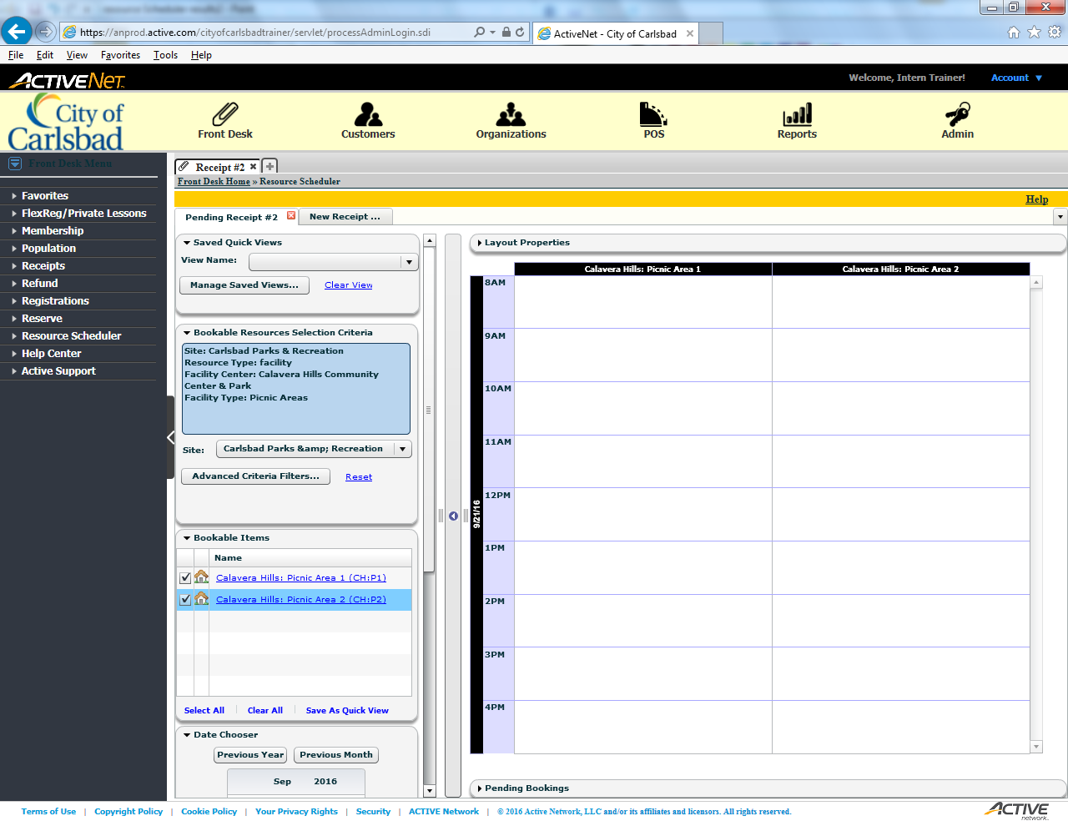
Tip:
Collapse the Bookable Items field

Slide 18
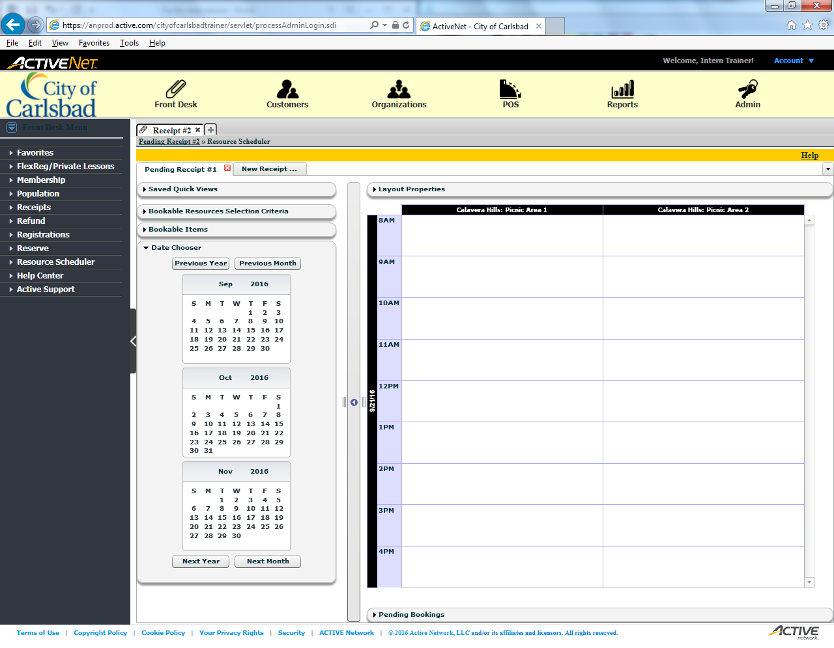
Tip:
Select September 18 from the calendar

Slide 19

Tip:
Click on the 11AM line for Calavera PA #1
Normally, you would click and drag for the allotted time slot.

Slide 20
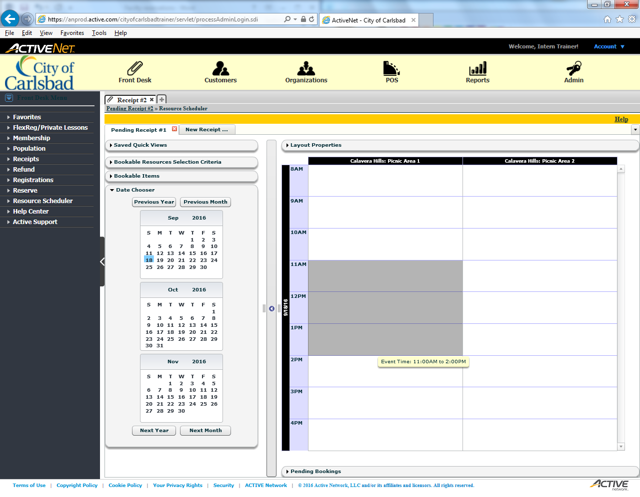
Tip:
You would normally drag your mouse.
This would allot time at the particular location. For now, click the gray area.

Slide 21
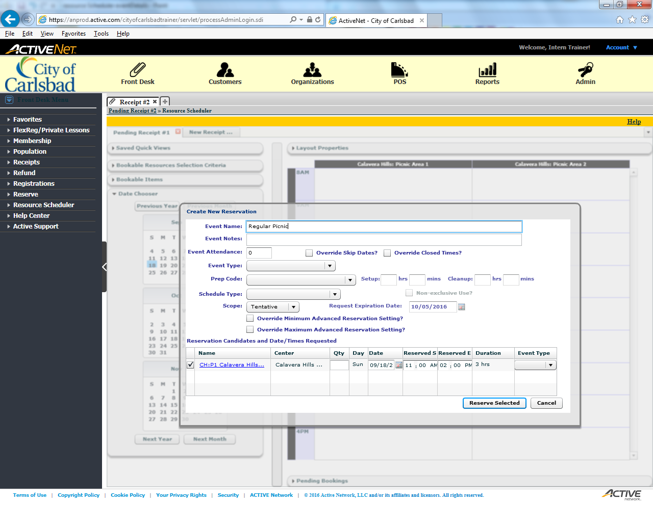
Tip:
Enter an Event Name
This is what would appear on the reservation sign.

Slide 22
Tip:
Enter any Event Notes, if applicable
For special setups, items the patron may be considering, etc.

Slide 23
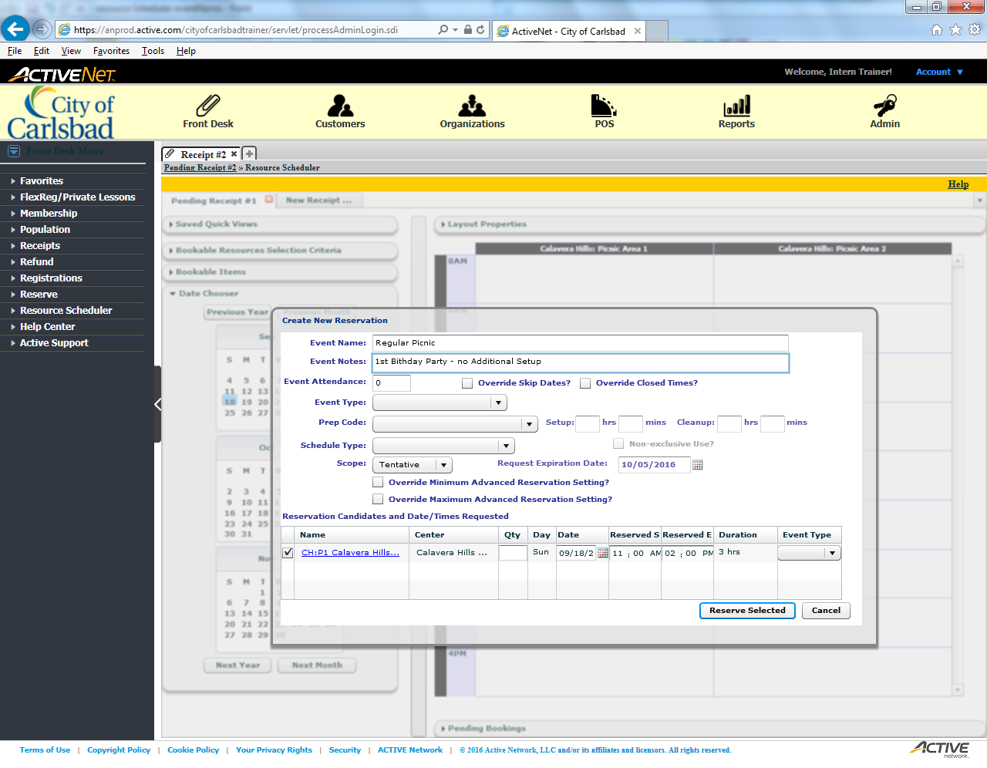
Tip:
Enter the Event Attendance
Please note that each area has a preassigned max. Ensure the acclaimed area can accommodate the attendance before continuing.

Slide 24
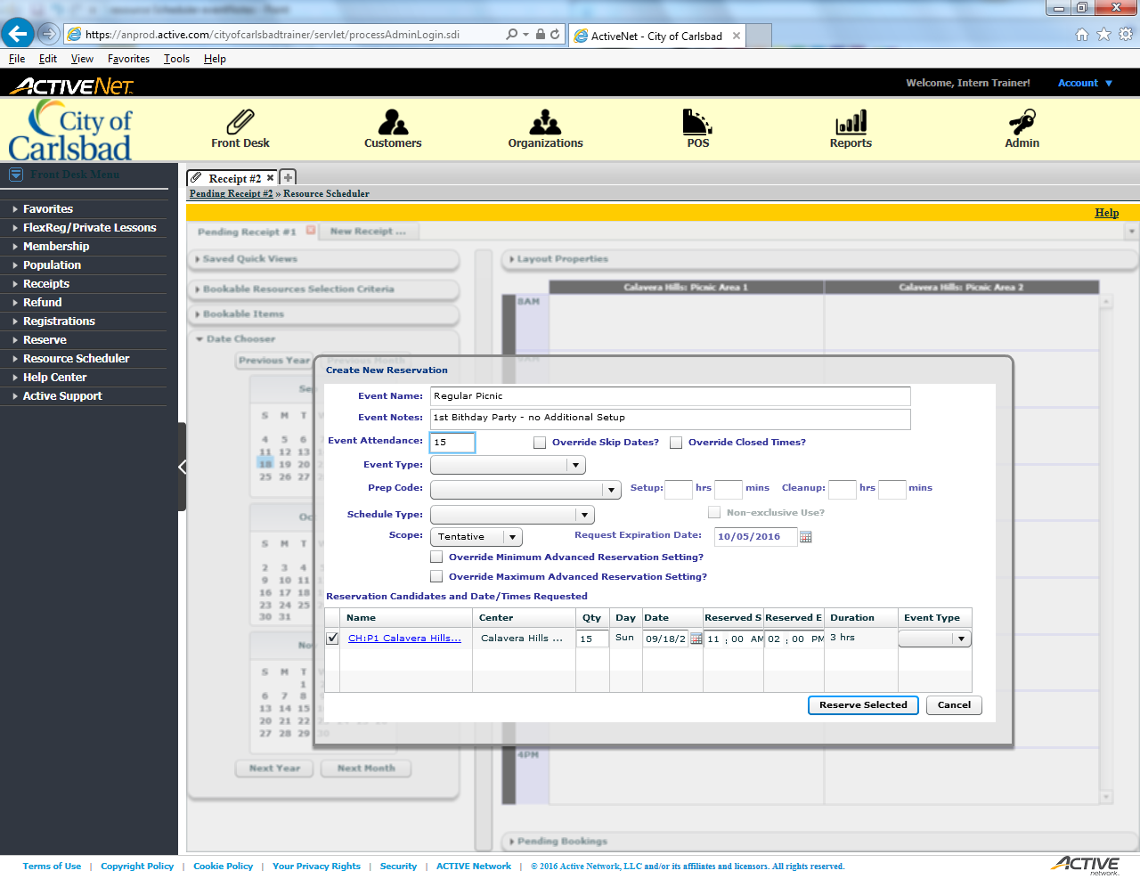
Tip:
Select an Event Type
For standard birthday parties, Picnic is the best category.

Slide 25
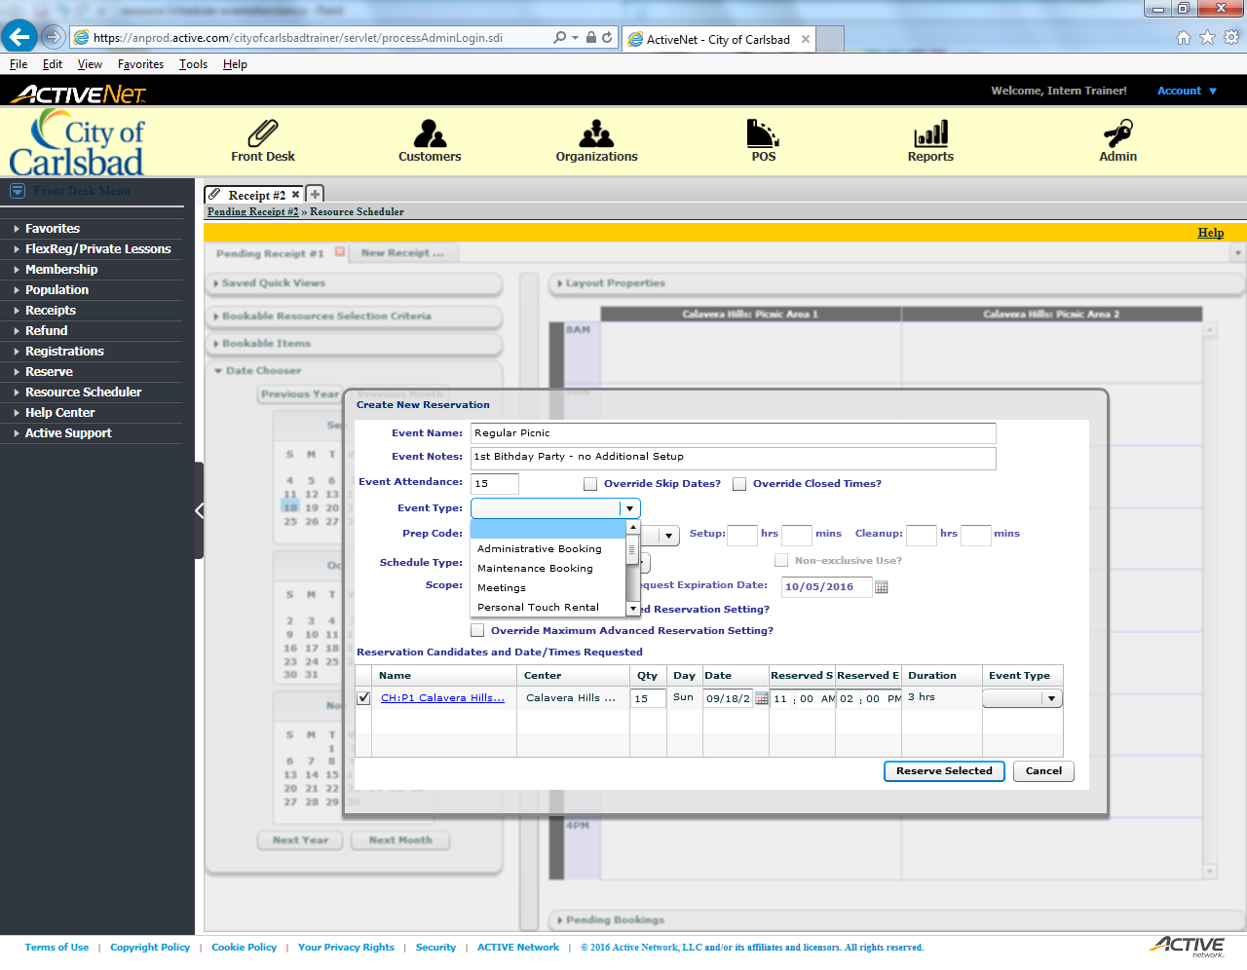
Tip:
Scroll until Picnic appears

Slide 26

Tip:
Select Picnics

Slide 27
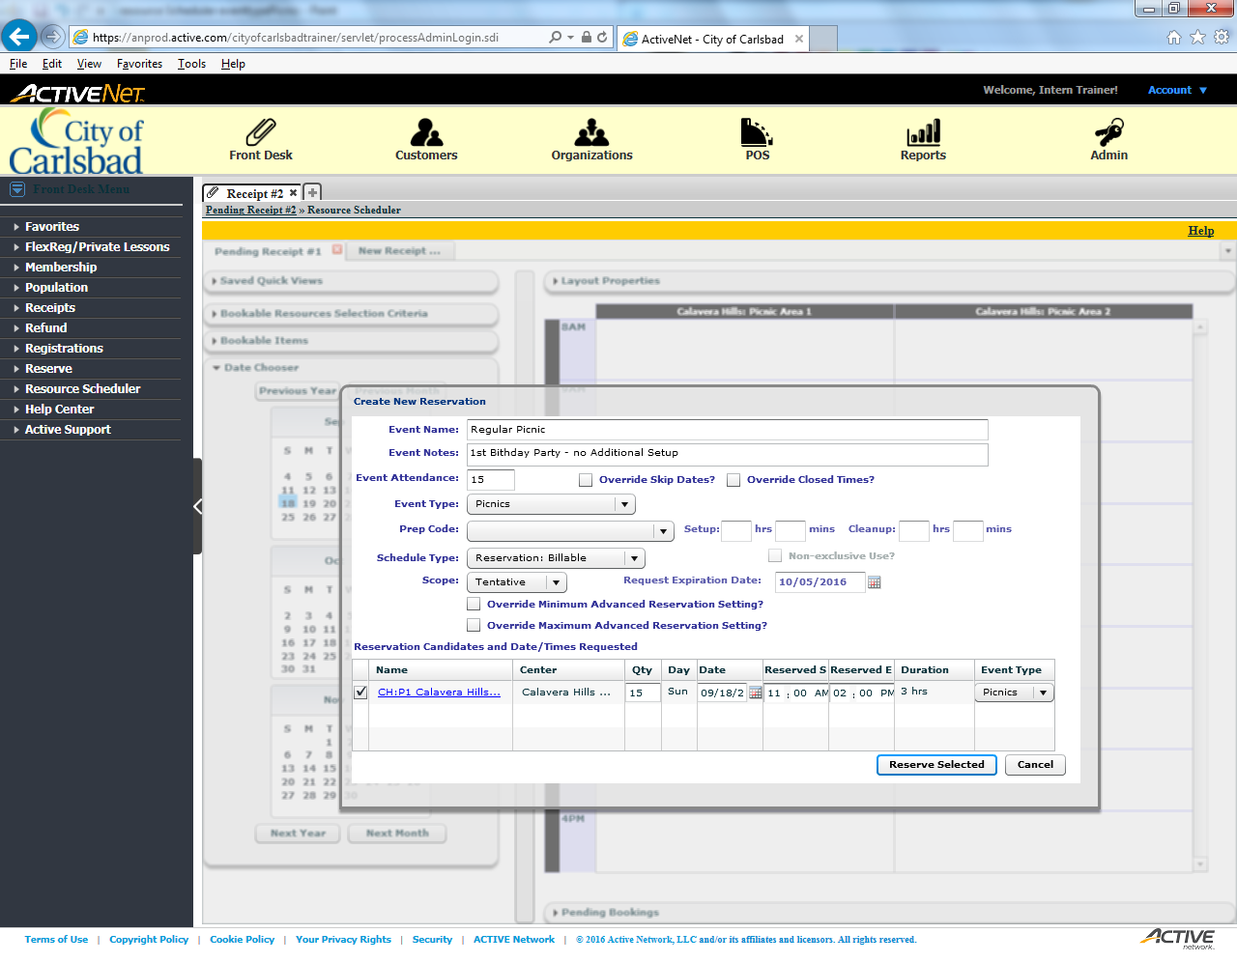
Tip:
Select Reserve Selected

Slide 28
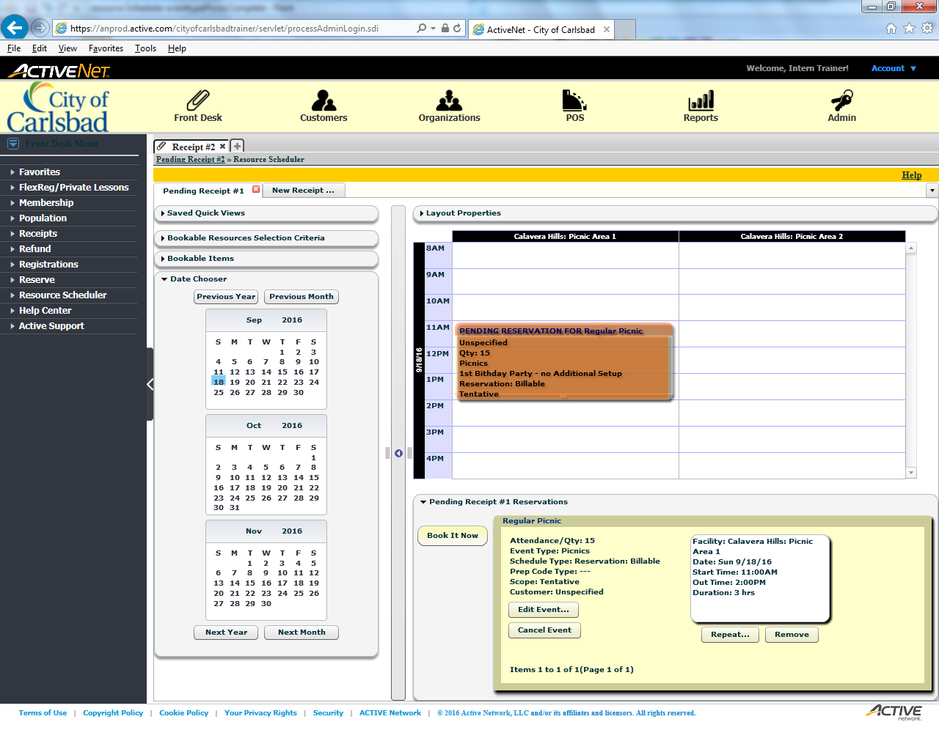
Tip:
After verifying the details, select Book Now

Slide 29
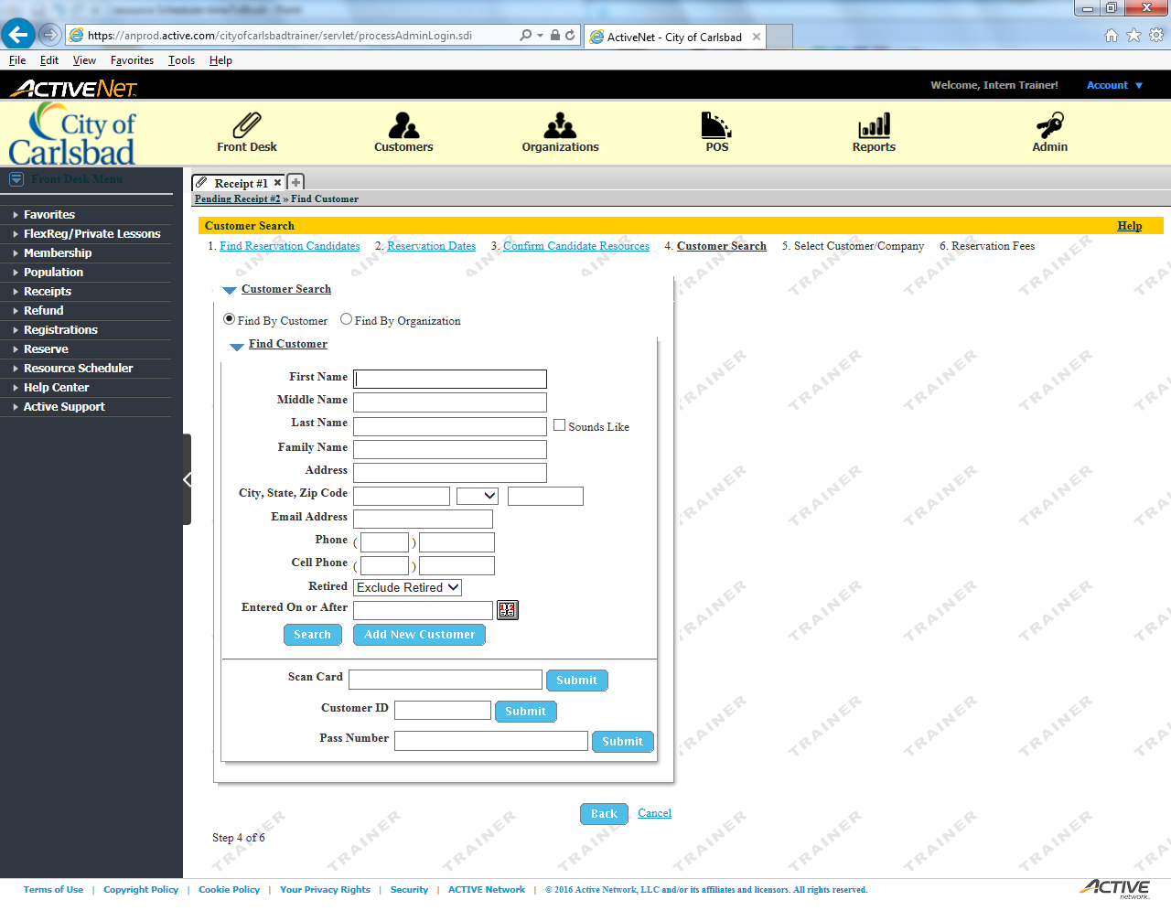
Tip:
Enter the First Name of the client

Slide 30
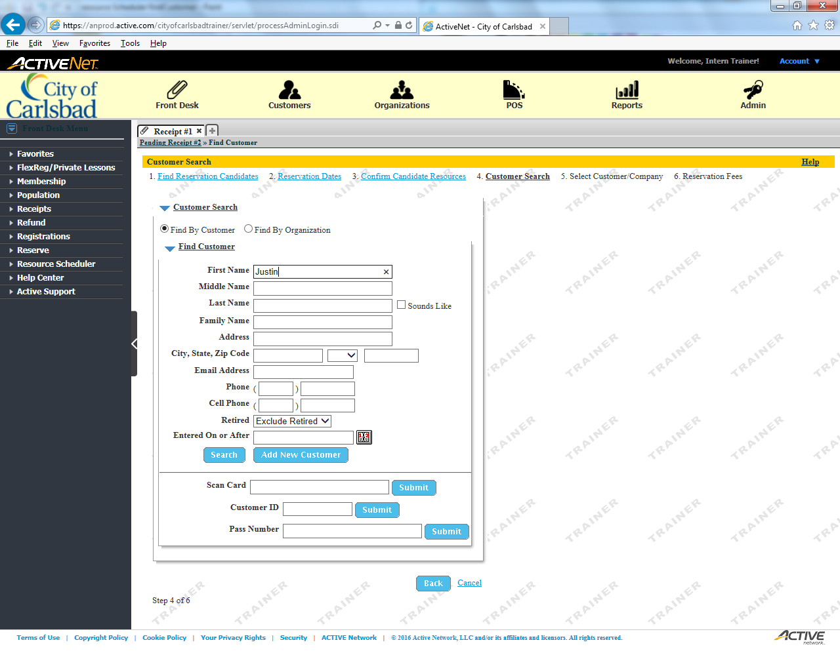
Tip:
Enter the Last Name of the client

Slide 31

Tip:
Select Search

Slide 32
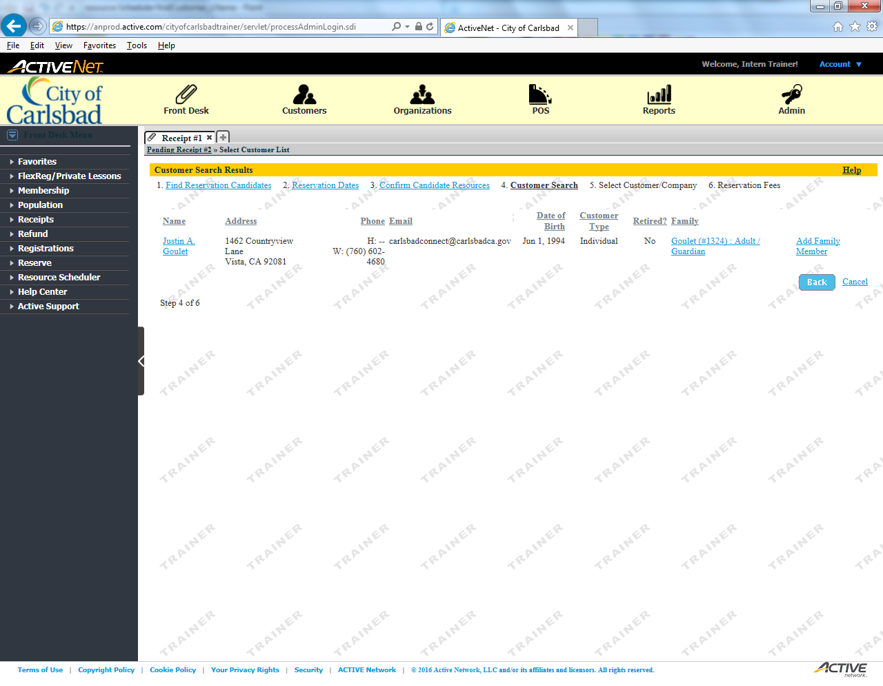
Tip:
Select the appropriate client from the list

Slide 33
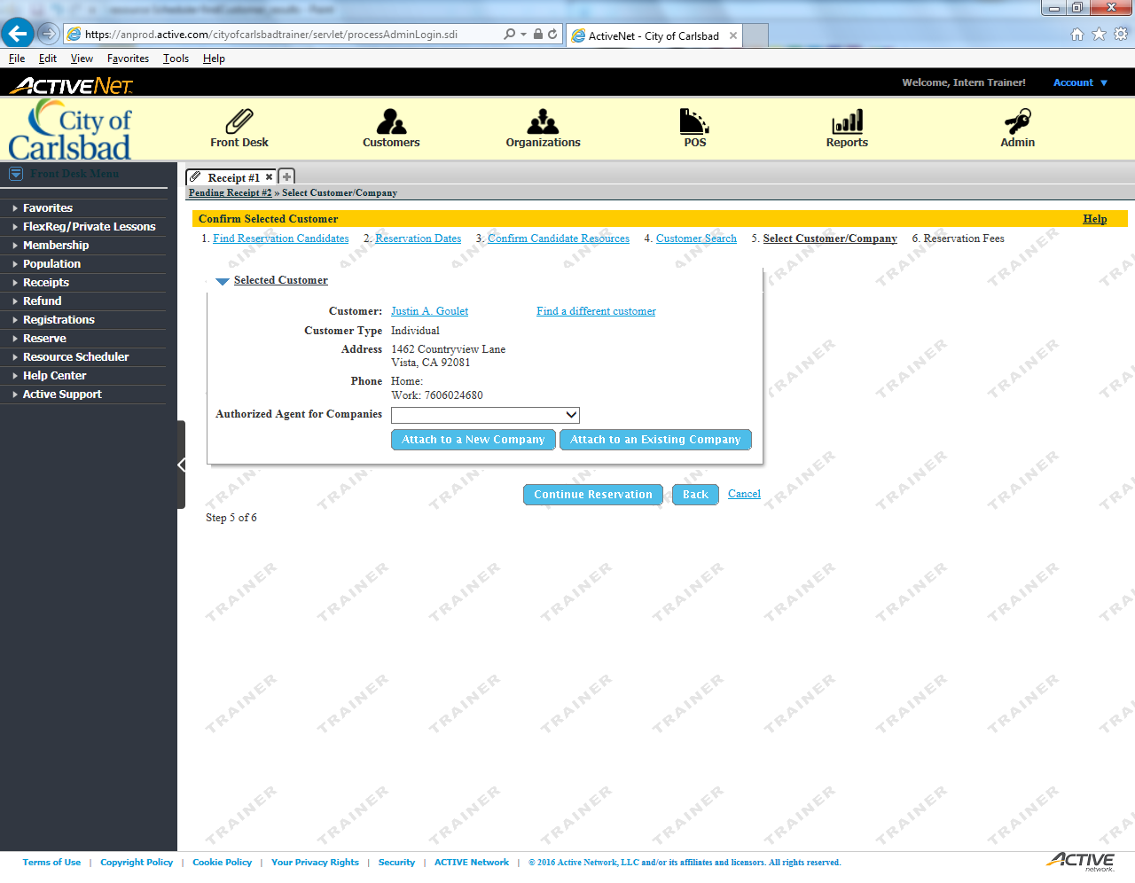
Tip:
Continue onto permit details

Slide 34
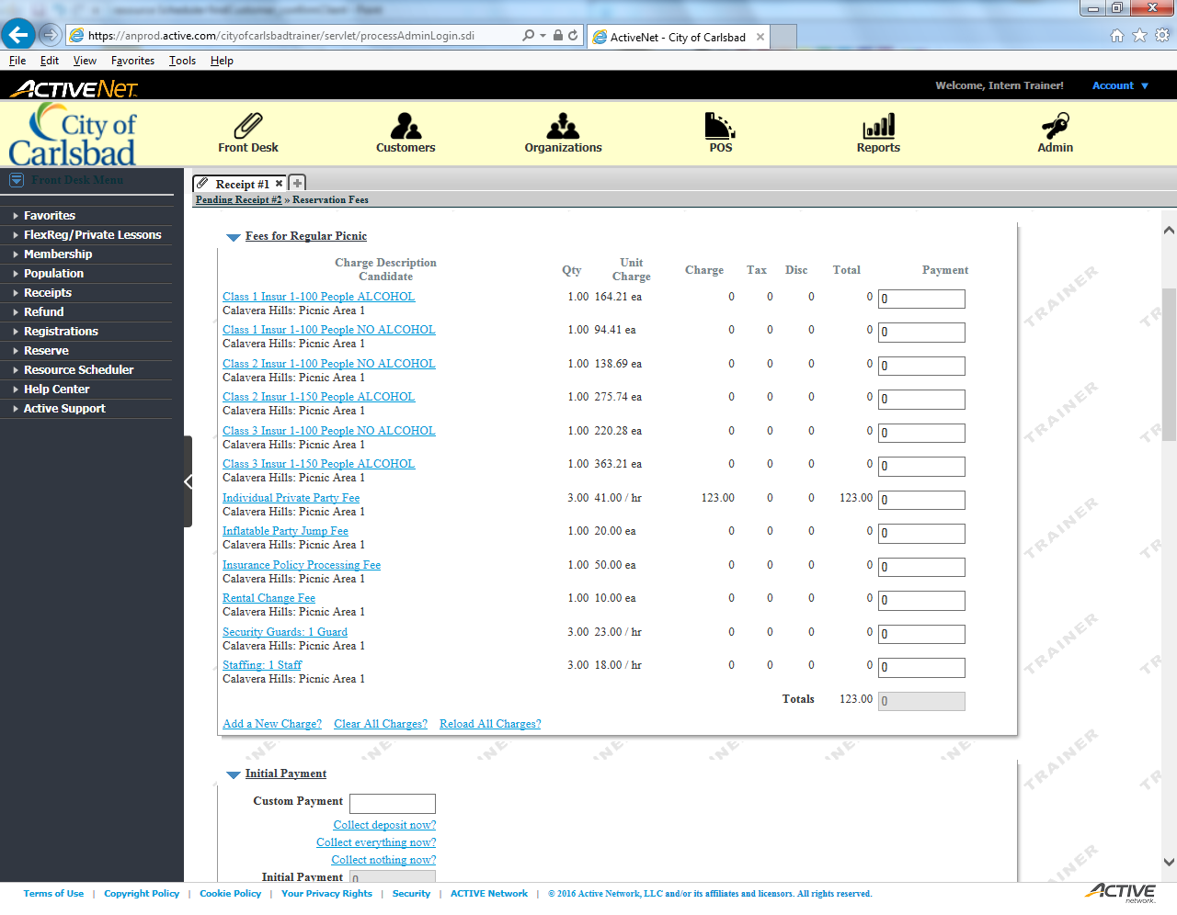
Inflatable Party Jumps are not available in all areas!
For example, they are allowed in
Calavera Hills PA #1
but not
Calavera Hills PA #2
Tip:
Add an Inflatable Party Jump Fee
This fee must be included for all reservations with a party jump. Ensure they are allowed at the location before continuing.

Slide 35
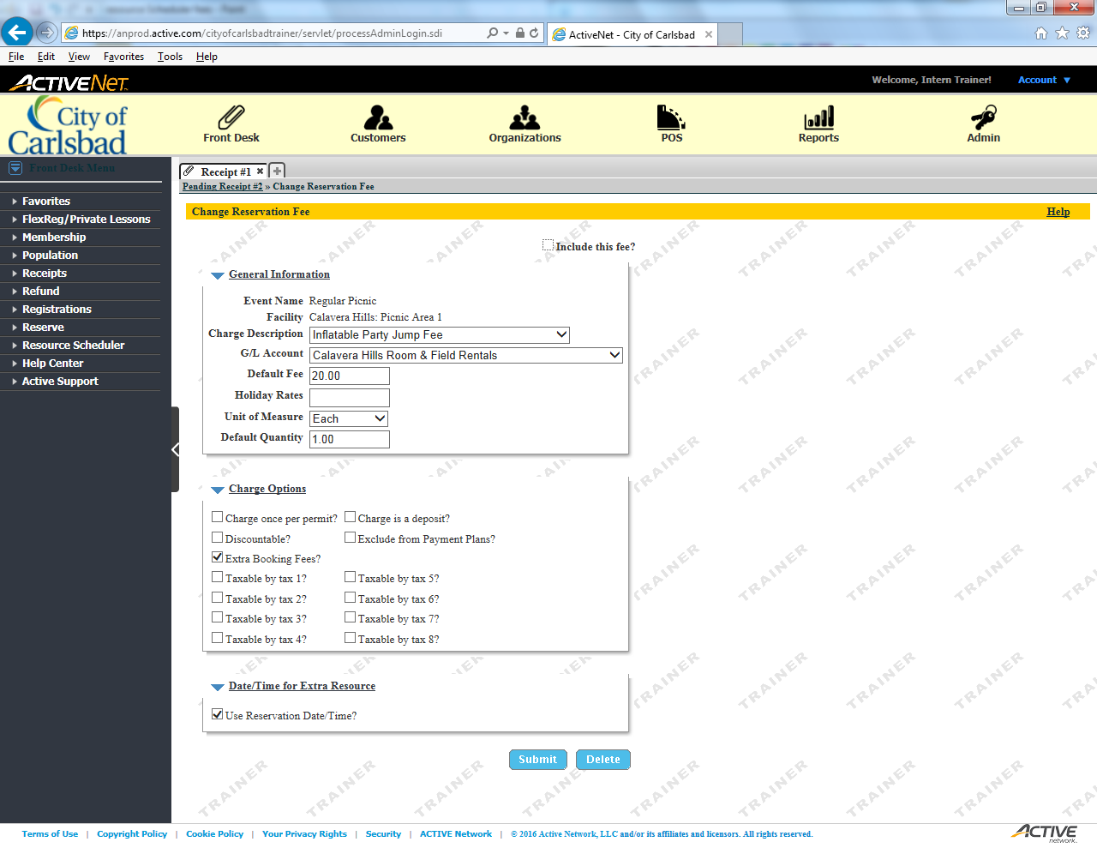
Tip:
Select to Include this Fee

Slide 36
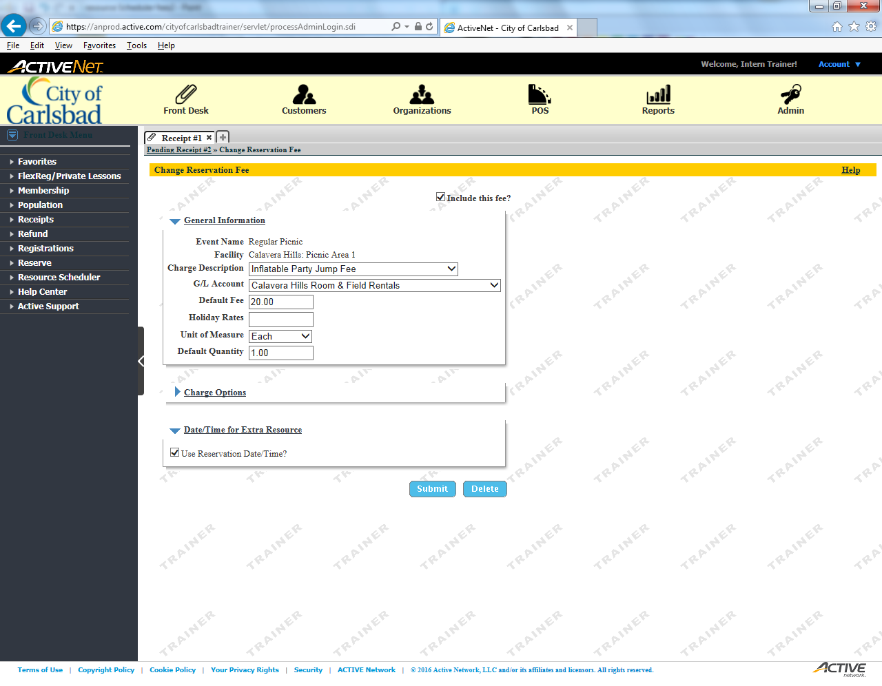
Tip:
Submit the changes

Slide 37

Tip:
Verify the fees were added, then collapse the view

Slide 38
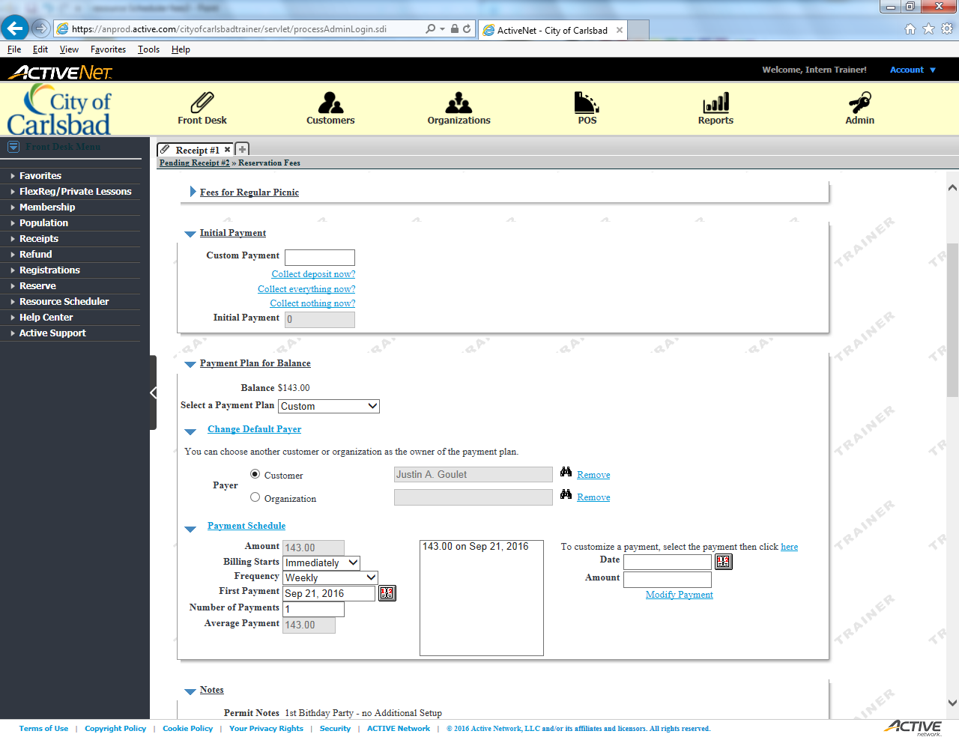
Tip:
Collect Everything Now
If the caller came to the facility or called in, payment in full is due immediately. If the patron completed the permit online, payment is due within 24 hours from creation.

Slide 39
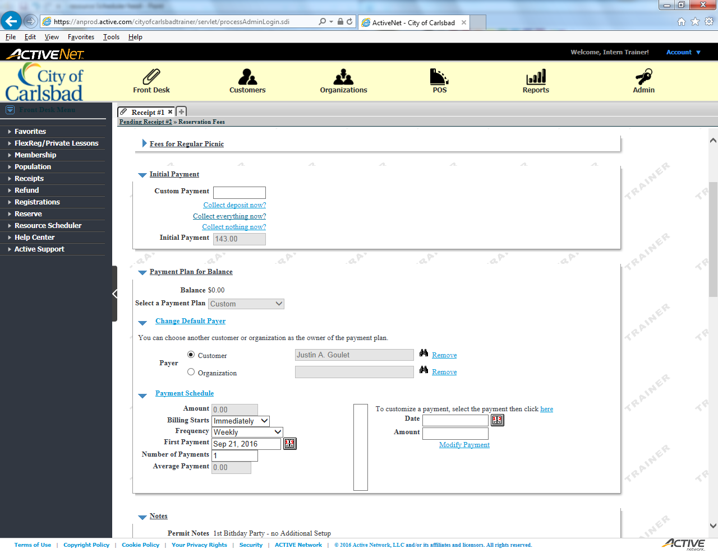
Tip:
Collapse the Payment Plan section
Birthday parties and picnic reservations do not meet the requirements for a payment plan.

Slide 40
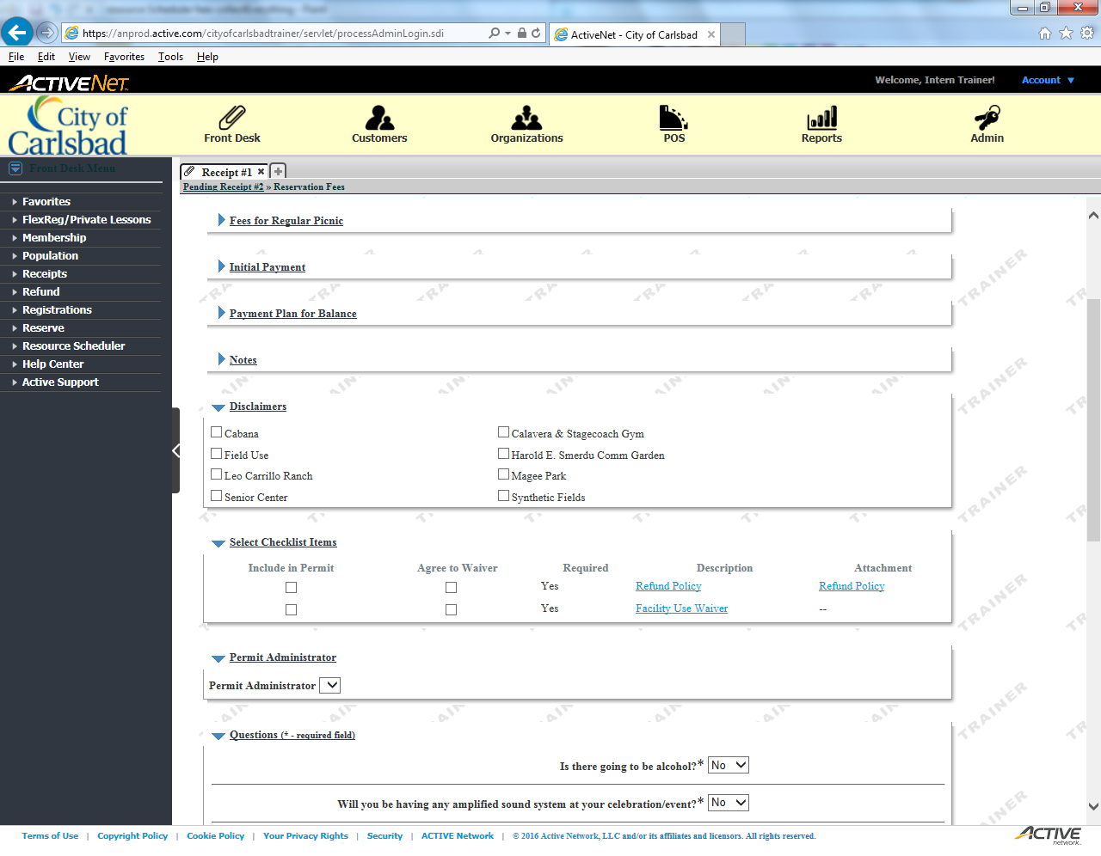
Tip:
Include the Refund Policy in the permit

Slide 41
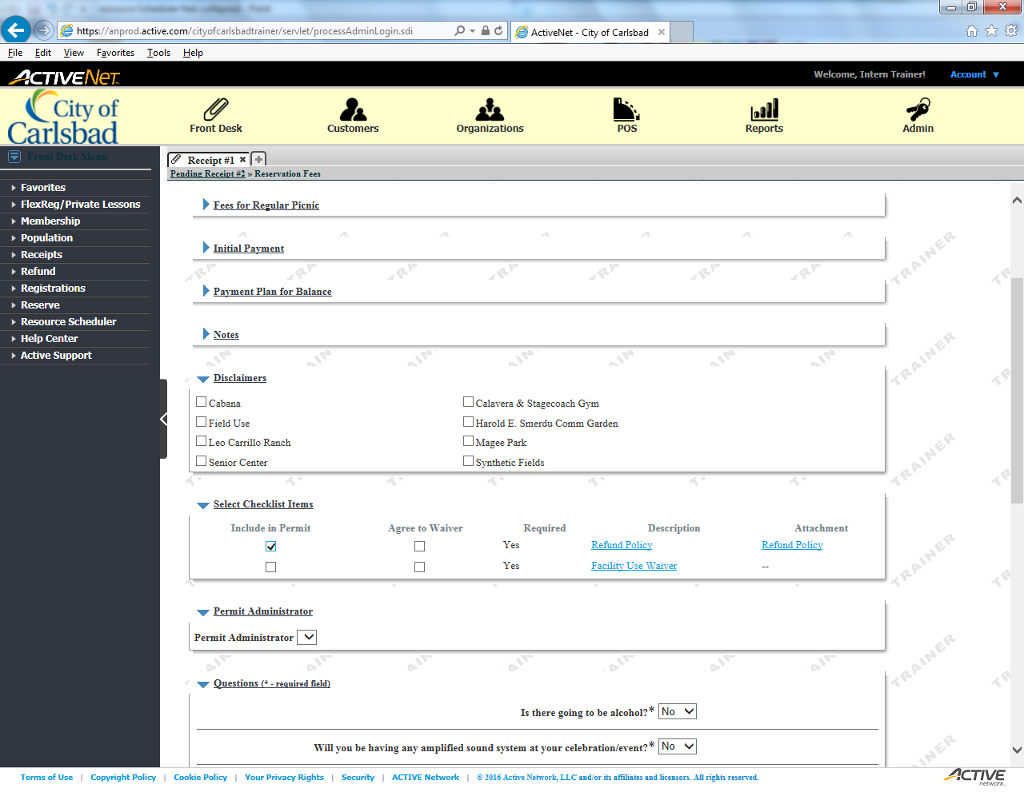
Tip:
Include the Use Waiver in the permit

Slide 42

Tip:
Ensure the client agrees to the Refund Policy

Slide 43

Tip:
Ensure the client agrees to the Use Waiver

Slide 44

Tip:
Collapse the Checklist Items section

Slide 45
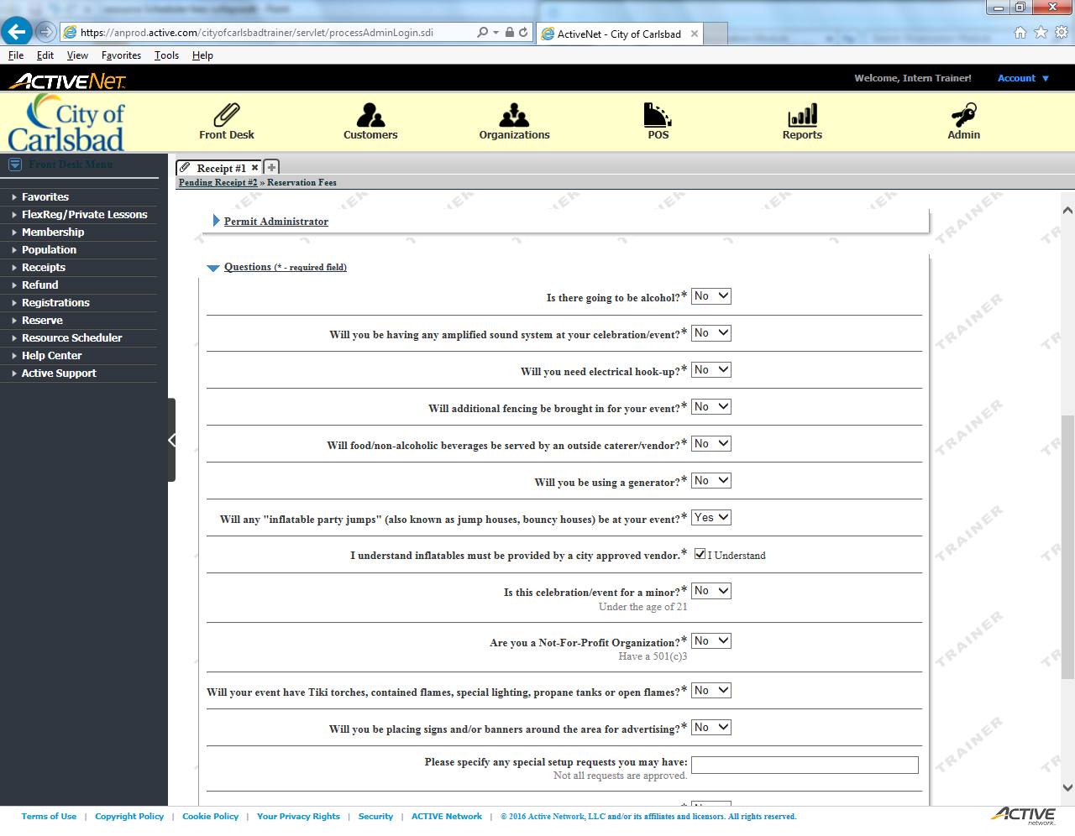
Tip:
Ask and Respond to each of the required questions.
Although all questions may not pertain to the user, these questions are used to determine the scope of the event. Collapse for now.

Slide 46
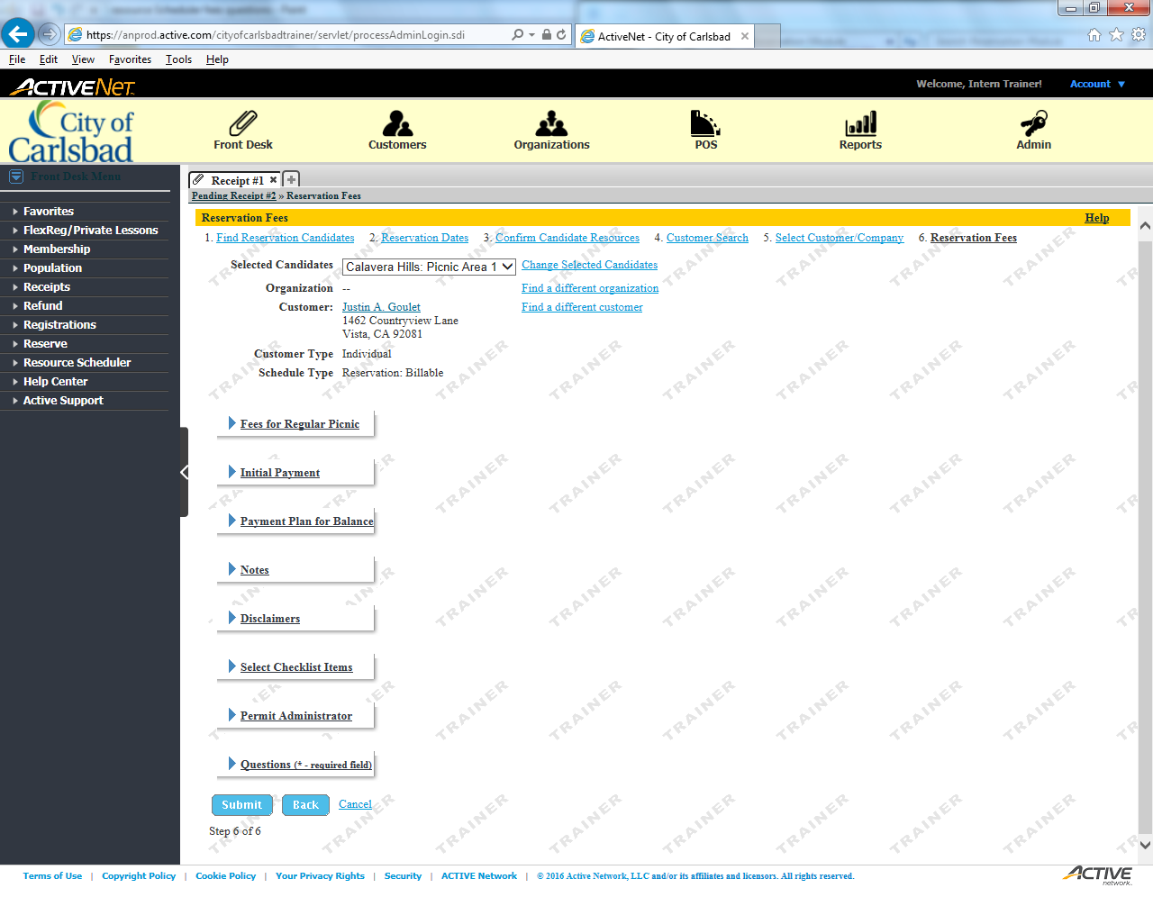
Tip:
Select Submit

Slide 47
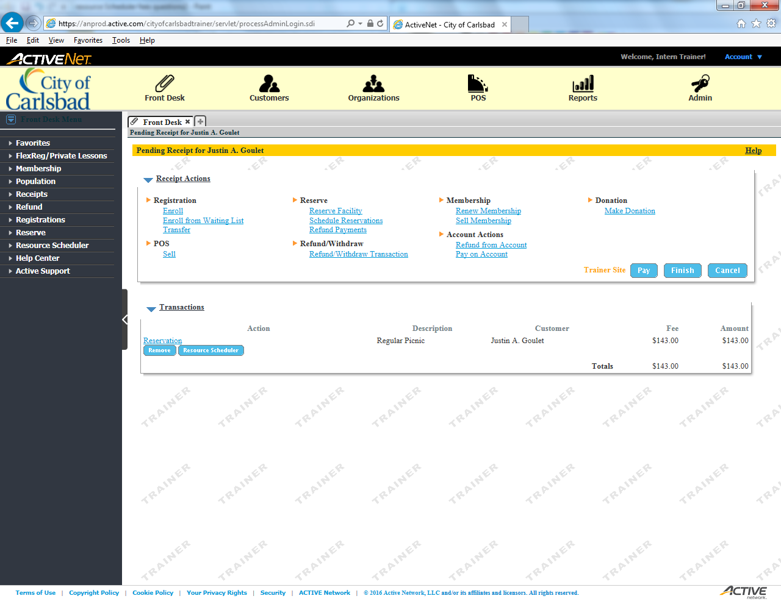
Tip:
Main Text Instruction Will Go Here
Progress to payment information
Sub Instruction Here

Slide 48
Error!
Please follow the on-screen
instructions to continue.
Go Back

Slide 49
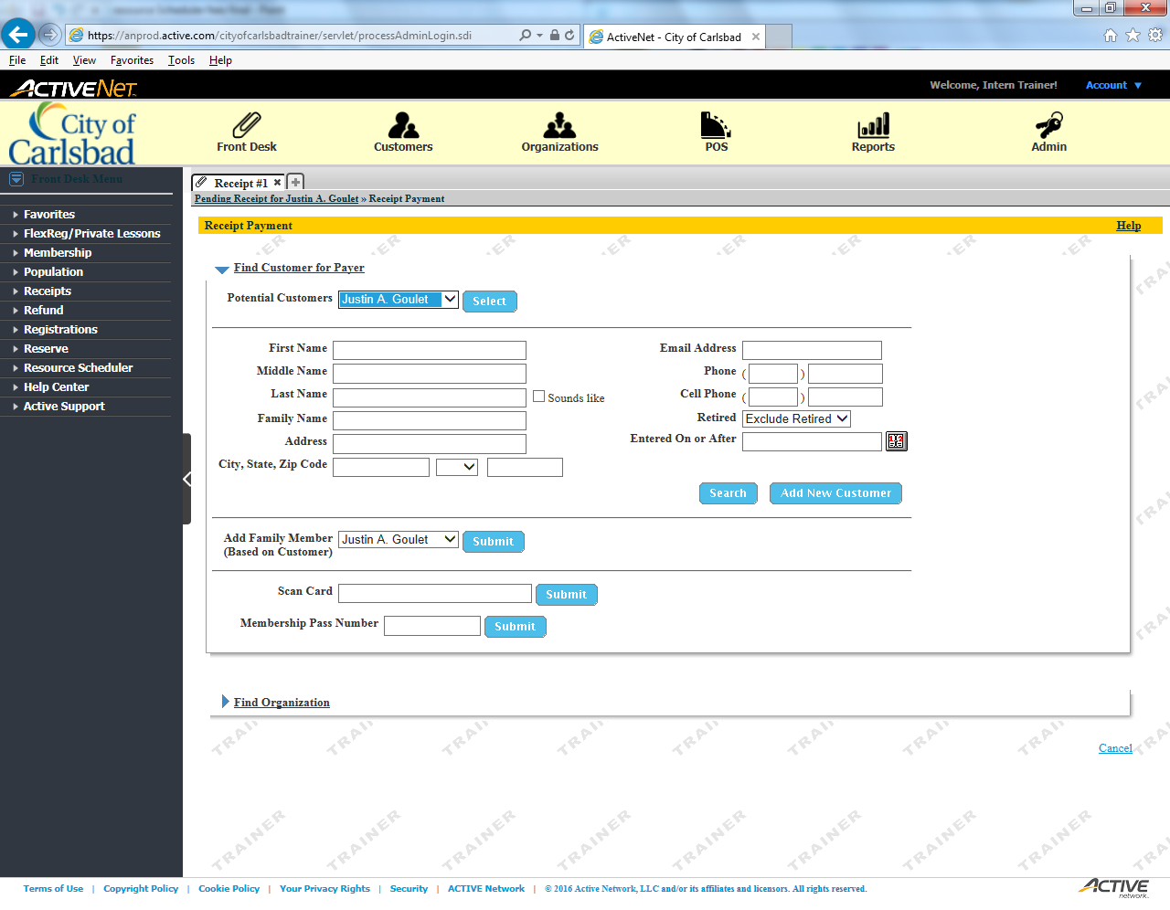
Tip:
Main Text Instruction Will Go Here
Select the current customer as the Payer
Sub Instruction Here

Slide 50
Error!
Please follow the on-screen
instructions to continue.
Go Back

Slide 51
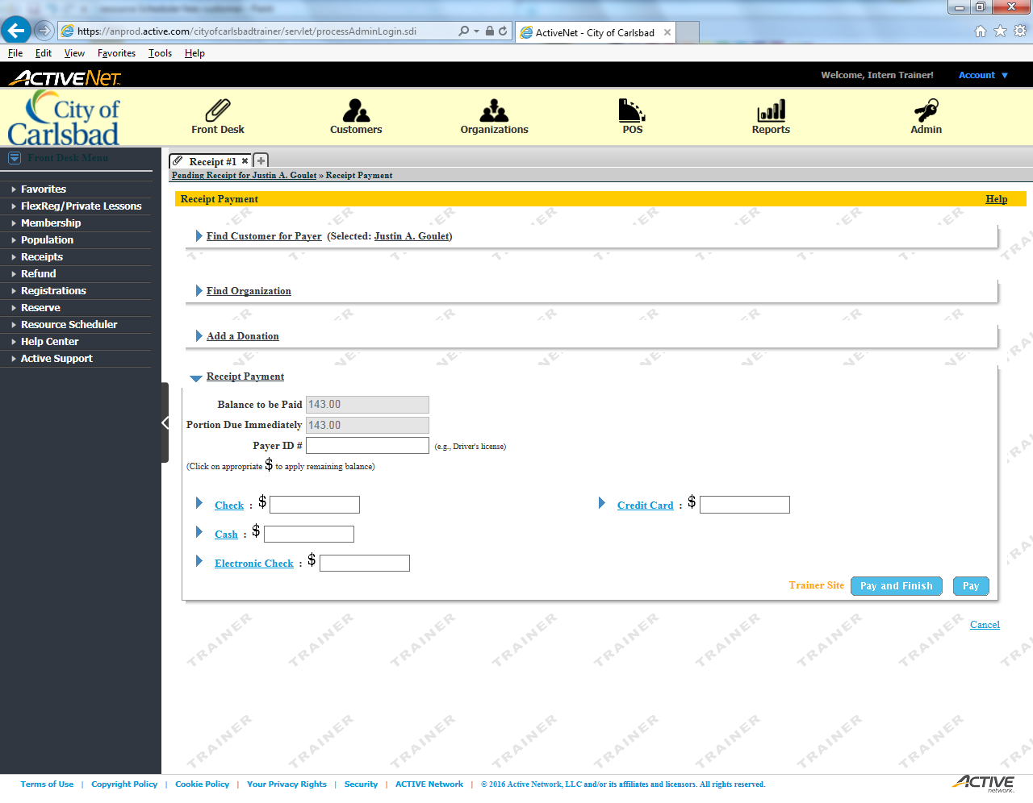
Tip:
Main Text Instruction Will Go Here
Select the $ to auto apply the full amount
Sub Instruction Here

Slide 52
Error!
Please follow the on-screen
instructions to continue.
Go Back

Slide 53

Tip:
Main Text Instruction Will Go Here
Pay and Finish to finish the transaction
Sub Instruction Here

Slide 54
Error!
Please follow the on-screen
instructions to continue.
Go Back

Slide 55
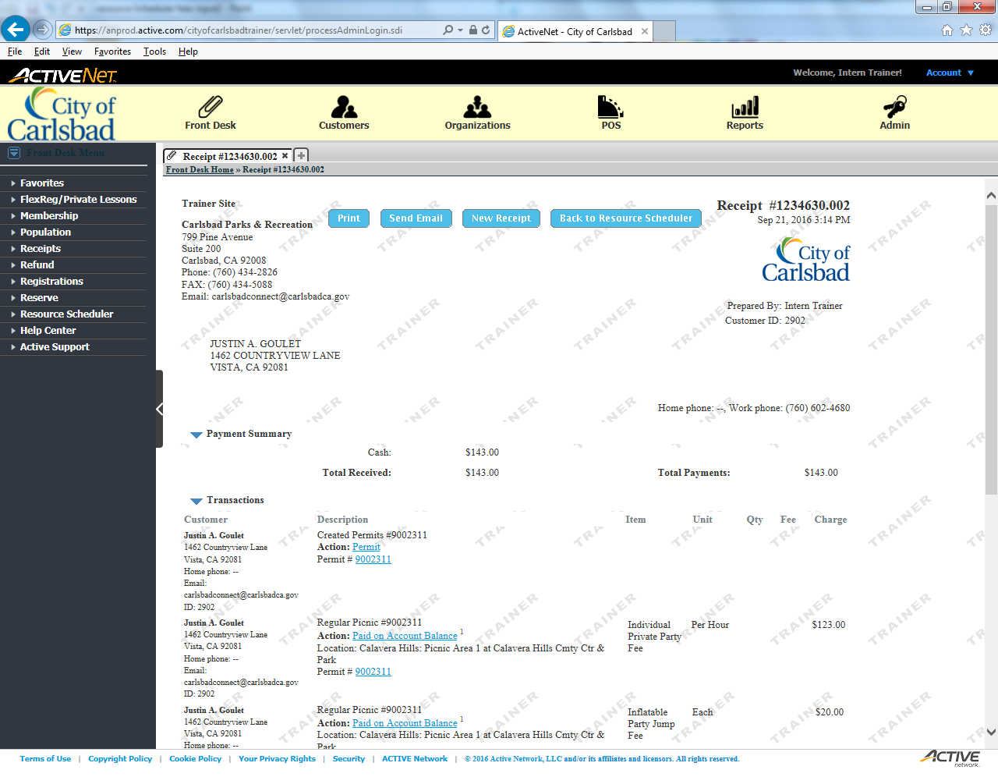
Tip:
Main Text Instruction Will Go Here
Send an Email Receipt to the client
Sub Instruction Here

Slide 56
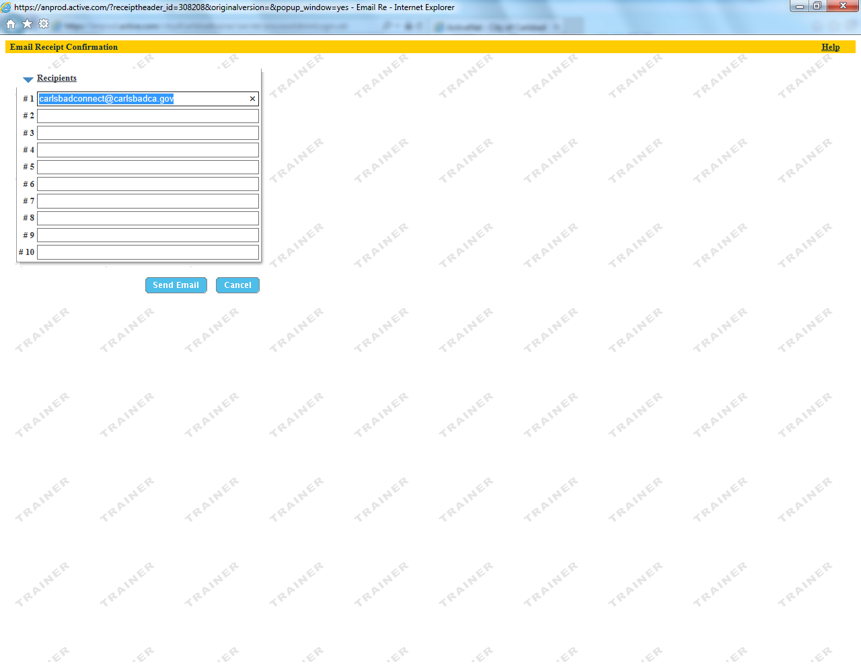
Tip:
Main Text Instruction Will Go Here
Confirm the email and send
Sub Instruction Here

Slide 57
Tip:
Main Text Instruction Will Go Here
Go to the Temporary Permit to approve it
All permits are tentative until approved. Have your specialist verify the permit before you approve it.
Sub Instruction Here

Slide 58
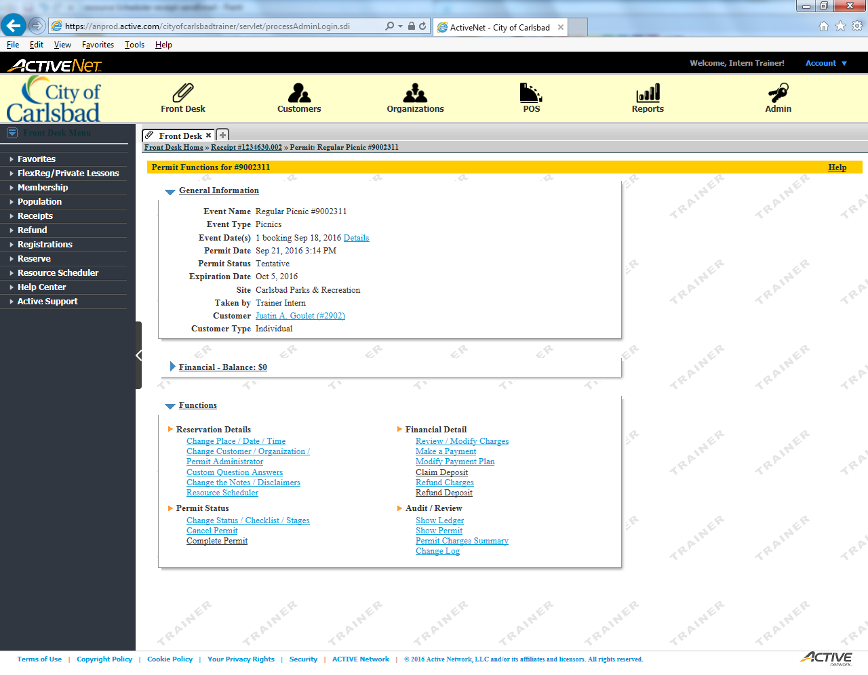
Tip:
Select to Change Status / Stages
Main Text Instruction Will Go Here
Sub Instruction Here

Slide 59
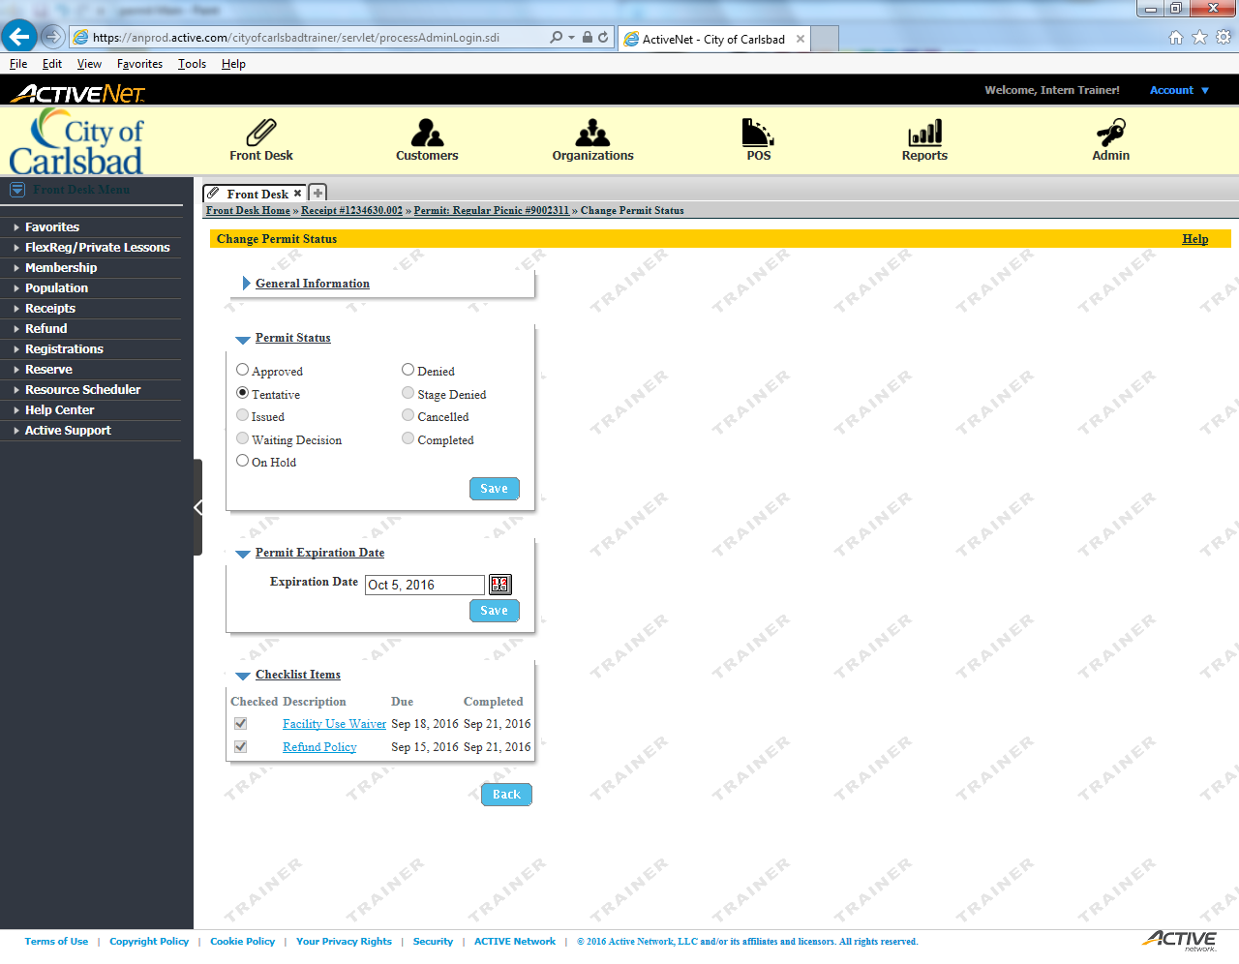
Tip:
Main Text Instruction Will Go Here
Set the status to Approved
Sub Instruction Here

Slide 60

Tip:
Main Text Instruction Will Go Here
Save your changes
Sub Instruction Here

Slide 61

Tip:
Main Text Instruction Will Go Here
Show the updated permit
Sub Instruction Here

Slide 62
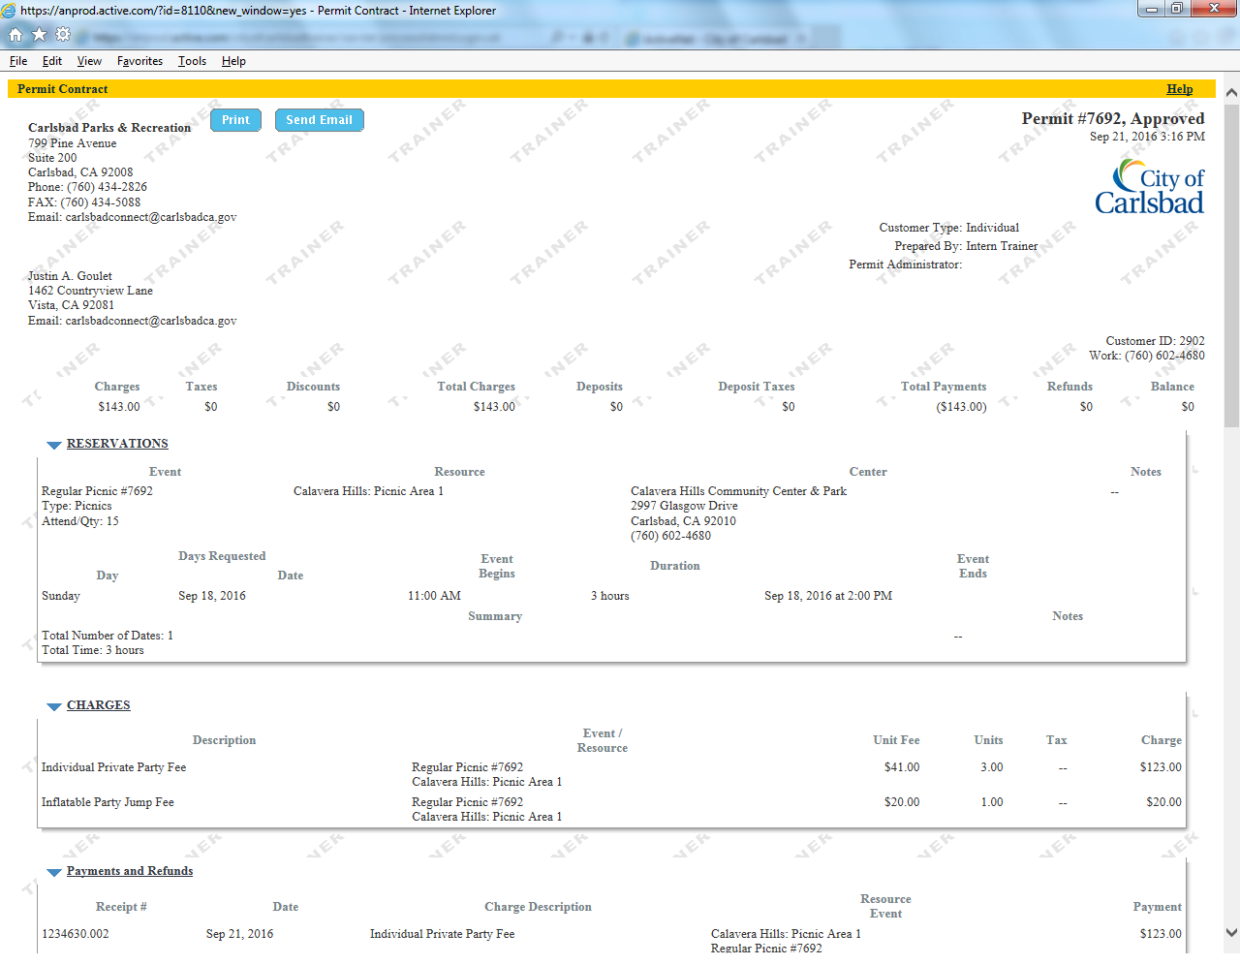
Tip:
Main Text Instruction Will Go Here
Send the Approved Permit to the client
Sub Instruction Here
They must have access to it on the day of the event, if requested.

Slide 63
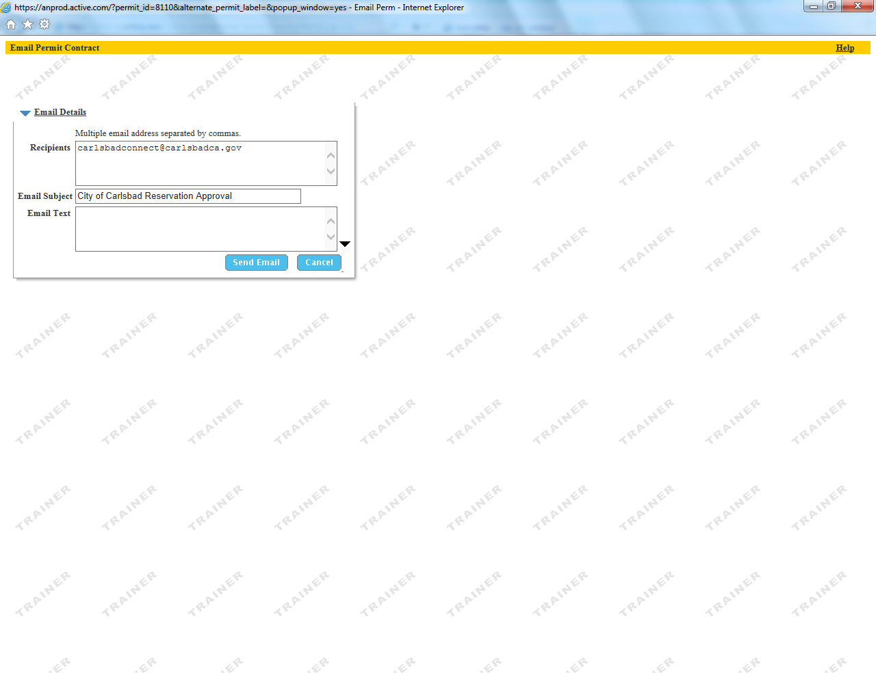
Tip:
Main Text Instruction Will Go Here
Confirm the email and send to the client.
Sub Instruction Here
Your supervisor will automatically get updates on every permit you create.

